Slide 1
Processes & Threads Scheduling

Slide 2
Review
Process Model
Pseudo-parallelism (Multi-programming, quantum or time slice)
Context Switch (user mode ↔ kernel mode, switch CPU to other process – load/store PCB)
Scheduling algorithm
PCB
Id, registers, scheduling information, memory management information, accounting information, I/O status information, …
State (New, Running, Ready, Blocked, Terminal)
CPU Utilization
Shows the CPU utilization
1 – p^{n}

Slide 3
Review
Threads
Share the same address space and resources of the process
Each thread has its own PC, registers and stack of execution
There is no protection between threads in one process
Have its own stack
Improve context switch among processes, optimize quantum
Are implemented in 3 modes: user, kernel, hybrid

Slide 4
Review
IPC
Resolving
Race condition (Critical Region)
Busy waiting (Priority Inversion)
Good solution for race condition
Software: Peterson solution (2 control variables)
Hardware: TSL (atomically, individual)
Good solution for race condition and busy waiting
Software: binary semaphore (recommending about order in using), monitors
Hardware: mutexes

Slide 5
Objectives
Scheduling
Introduction
Process Behavior
When to schedule
Categories of Scheduling algorithms
Criteria/ Properties Term
Scheduling in Batch System

Slide 6
Scheduling Introduction
Scheduler
OS component that decides what process will be run and for how long
Uses a scheduling algorithm
On OSs that support kernel-level threads, it is threads that are being scheduled
History
In the old days of batch system with input the form of card images on a magnetic tape: just run the next job on the tape
In early computers, CPU time was a scarce resource: good scheduling was of paramount importance!
Nowadays, the CPU is not a scarce resource any more! Furthermore, in PCs there aren’t many users competing… However, scheduling algorithms have become more sophisticated!

Slide 7
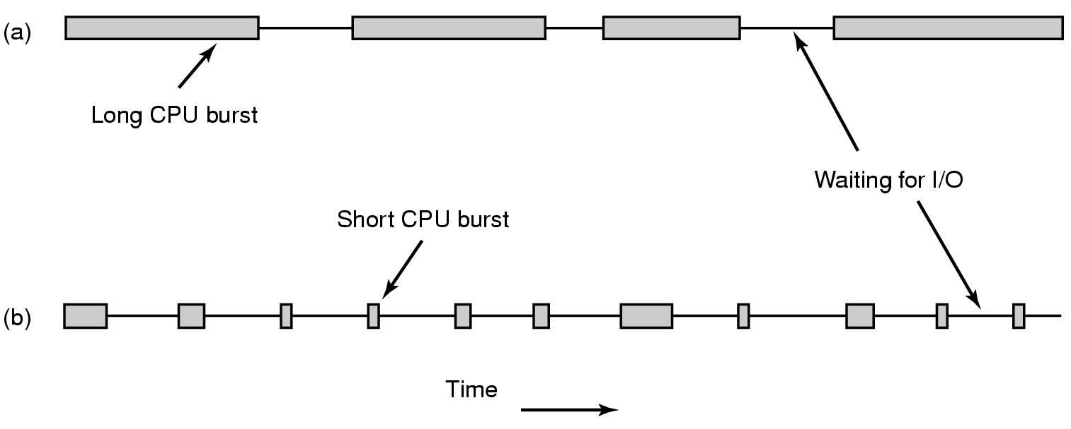
Scheduling Process Behavior
All process execution consists of a cycle of bursts of computing (CPU execution) and I/O request (I/O wait)
Compute-bound processes
Spend most of their time computing
Have long CPU bursts and thus infrequent I/O waits
I/O-bound processes
Spend most of their time waiting for I/O
Have short CPU bursts and thus frequent I/O waits
Tanenbaum, Fig. 2-38.

Slide 8
Scheduling Process Behavior
Example
load store
add store
read from file
CPU burst
Process execution begin with CPU burst, then I/O burst … the last CPU burst will end with a system request to terminal execution
wait for I/O
I/O burst
store increment index
write to file
CPU burst
wait for I/O
I/O burst

Slide 9
Scheduling When to schedule
A key issued related to scheduling is when to make scheduling decisions
Process creation
A decision needs to be made whether run the parent or child process
Process termination
A decision must be made when a process exits. That process can no longer run, so some other process must be chosen from the set of ready processes. If no process is ready, a system-supplied idle process is normally run
Process blocking
When a process blocks, another process has to be selected to run

Slide 10
Scheduling When to schedule
Interrupt occurrence
If the interrupt came from an I/O device that has now completed its work, some process that was blocked waiting for the I/O may now be ready to run
Clock interrupt occurrence
non-preemptive scheduling algorithms
preemptive scheduling algorithms
CPU scheduling decisions may take place when a process:
Switches from running to blocked state (I/O or wait for child processes).
Switches from running to ready state (interrupted).
Switches from blocked to ready (completion of I/O).
Terminates.
→ The process executes following above steps in order, we can say it is scheduled in non-preemptive. Otherwise, it is scheduled in preemptive

Slide 11
Scheduling When to schedule
non-preemptive scheduling algorithms
Picks a process to run and then just lets it run until it blocks or until it voluntarily releases the CPU (will not be forceably suspended, no scheduling decisions)
Once a process is in the running state, it will continue until it terminates or blocks itself for I/O
Applying to the batch system
preemptive scheduling algorithms
The process can run (continuously) for a maximum of some fixed time. If it is still running at the end of this time, it is suspended and the scheduler will pick another process to run (needs timer)
Currently running process may be interrupted and moved to the Ready state by the operating system
Allows for better service since any one process cannot monopolize the processor for very long
Applying to the time-sharing or real time

Slide 12
Scheduling Categories of Scheduling Algorithms
Batch
Non-preemptive algorithms
Preemptive algorithms with long time periods for each process
Reduces processes switches and increase performance
Interactive
Preemptive algorithms are needed to prevent the situation that the preemptive keeps one process from hogging the CPU and denying service to the others. Even if no process intentionally ran forever, one process might shut out all the others indefinitely due to a program bug
Real-Time
Preemption normally used, but sometimes not needed because the processes know that they may not run for long periods of time and usually do their work and block quickly

Slide 13
Scheduling Criteria/ Properties Term
Fairness – equivalent processes get equivalent CPU times
Policy enforcement – if the local policy is that safety control processes get to run whenever they want to, even if it means the payroll is 30 sec late, the scheduler has to make sure this policy enforced
Policy vs. Mechanism
The policies what is to be done
The mechanism specifies how it is to be done
The mechanism is a thing that implements the policy
Ex:
The timer construct for ensuring CPU protection (mechanism)
The decision of how long the timer is set for a particular user (policy)

Slide 14
Scheduling Criteria/ Properties Term
Throughput
The number of processes that complete their execution per time unit.
Ex: In long processes, the rate may be one process per hour. For short processes, it may be 10 processes per second.
Turnaround time
Amount of time to execute a particular process.
Is the sum of the periods spent waiting in the ready queue, executing on the CPU, doing I/O, etc…
Is the time from the process is submitted until it is completed (time of complete – arrival time)

Slide 15
Scheduling Criteria/ Properties Term
CPU utilization
The utilization of CPU.
Can range from 0 to 100 percent.
It should range from 40 percent (lightly loaded system) to 90 percent (heavily used system).
Response time
In an interactive system, turnaround time may not be the best criterion.
Often, a process can produce some output fairly early and can continue computing new results.
This measure is the amount of time it takes from when a request was submitted until the first response is produced.
Proportionality
When a request that is perceived as complex takes a long time, users accept that, but when a request that is perceived as simple takes a long time, users get irritated

Slide 16
Scheduling Categories of Scheduling Algorithms
All systems
Fairness – giving each process a fair share of CPU
Policy enforcement – seeing that stated policy is carried out
Balance – keeping all parts of the system busy
Batch systems
Throughput – maximize jobs per hour
Turnaround time – minimize time between submission and termination
CPU utilization – keep the CPU busy all the time
Interactive systems
Response time – respond (react) to request quickly
Proportionality – meet, if possible, user’s expectations
Real-time systems
Meeting deadlines – avoid losing data
Predictability – avoid quality degradation in multimedia systems

Slide 17
Scheduling in Batch System First-Come First Served (FCFS)
The simplest CPU scheduling algorithm!
Is non-preemptive (preemptive – ngắt ngang )
The process that entered the ready state first, will get the CPU first and will hold it until it is blocked (or finished)
Simple to understand and implement
It requires a single queue of ready processes:
If a process enters the ready state, it is linked onto the tail of the ready queue.
If the CPU is free, it takes the process at the head.

Slide 18
Scheduling in Batch System First-Come First Served (FCFS)
CPU
tail
head
…

Slide 19
Scheduling in Batch System First-Come First Served (FCFS)
CPU
P
tail
head
…
New

Slide 20
Scheduling in Batch System First-Come First Served (FCFS)
CPU
tail
head
…

Slide 21
Scheduling in Batch System First-Come First Served (FCFS)
CPU
P
tail
head
…
New

Slide 22
Scheduling in Batch System First-Come First Served (FCFS)
CPU
tail
head
…

Slide 23
Scheduling in Batch System First-Come First Served (FCFS)
CPU
tail
head
…

Slide 24

Scheduling in Batch System First-Come First Served (FCFS)
CPU
tail
head
…
Waiting time of each process: started process time – arrival time
Ex:
(Process:BurstTime) in order (P1:24), (P2:3), (P3:3)
Waiting time for P1 = 0; P2 = 24; P3 = 27
Average waiting time: (0 + 24 + 27)/3 = 17
Average Turnaround time: (24 + 27 + 30)/3 = 27

Slide 25
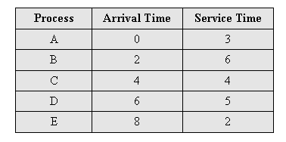
Scheduling in Batch System Example
Avg waiting time = 4.6
Avg turnaround time = 8.6
0
5
10
15
20
A
B
C
D
E

Slide 26

Scheduling in Batch System First-Come First Served (FCFS)
Consider FCFS scheduling in a dynamic situation where we have one CPU-bound process and many I/O-bound process.
The CPU-bound process will get and hold the CPU.
All the other processes will finish their I/O and will move into the ready queue, waiting for the CPU.
Eventually, the CPU bound process moves to an I/O devices.
All the I/O-bound process execute quickly and move back to the I/O queues.
Again, the CPU-bound process will then move back and hold the CPU, and all the I/O processes have to wait in the ready queue.
The above situation is called a convoy effect.
All the other processes wait for the one big process to get of the CPU.
Result in lower CPU and device utilization.
Ex:
(Process:BurstTime) in order (P2:3), (P3:3), (P1:24)
Waiting time for P1 = 6; P2 = 0; P3 = 3
Average waiting time: (6 + 0 + 3)/3 = 3
Average turnaround time: (6 + 3 + 30)/3 = 13

Slide 27
Scheduling in Batch System First-Come First Served (FCFS)
 | (P1:24), (P2:3), (P3:3) | (P2:3), (P3:3), (P1:24)
Avg Waiting Time | 17 | 3
Avg Turnaround Time | 27 | 13

Slide 28

Scheduling in Batch System Shortest Job First (SJF)
Runtime is known in advance (nonpreemptive)
When several equally important jobs are sitting in the input queue waiting to be started, the scheduler picks the shorted job first
Another more appropriate term – shortest-next-CPU-burst scheduling algorithm
When the CPU is available, it is assigned to the process that has the smallest next CPU burst
Is the optimal algorithm (only) when all the jobs are available simultaneously
Ex:
(Process:BurstTime) (P1:6), (P2:8), (P3:7), (P4: 3)
Average waiting time: (3+ 16 + 9 + 0)/4 = 7
Average turnaround time: (3 + 9 + 16 + 24)/4 = 13
Notes:
Thằng nào ngắn , CPU chạy trước

Slide 29
Scheduling in Batch System Example
Avg waiting time = 3.6
Avg turnaround time = 7.6
0
5
10
15
20
A
B
C
D
E

Slide 30
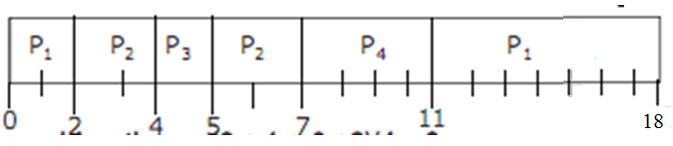
Scheduling in Batch System Shortest Remaining Time Next (SRT)
Is a preemptive version of shortest job first
The scheduler always chooses the process whose remaining runtime is the shortest
Preempt the currently executing process, if the next CPU burst of the newly arrived process is shorter than “what is left” of the currently executing process
When a new job arrives, its total is compared to the current process’s remaining time.
If the new job needs less time to finish than the current process, the current process is suspended and the new job started
Ex:
(Process:ArrivalTime:BurstTime) (P1:0:9), (P2:2:4), (P3:4:1), (P4:5:4)
Average waiting time: (9+ 1+ 0 + 2)/4 = 3
Average turnaround time: (18 + 5 + 1 + 6)/4 = 7.5
Notes:
Thời gian còn lại ngắn nhất sẽ được thực hiện
Burst time: tg thực hiện
Phủ đầu : đang chạy bị chặn lại
Burst time = cpu cicle
Average turnaround = burstTime + waitingTime

Slide 31
Scheduling in Batch System Example
Avg waiting time = 3.2
Avg turnaround time = 7.2
0
5
10
15
20
A
B
min(1, 6)
Min(5, 4)
C
Min(5, 5, 2)
E
Min(5, 2, 5)
D
Min(5, 5)

Slide 32
Summary
Scheduling
Q&A

Slide 33
Next Lecture
Scheduling (cont)
Classic IPC Problems

